Slide 1
The science of guessing: analyzing an anonymized corpus of 70 million passwords
Presented by
Wadha Al Khater

Slide 2
Introduction
Text passwords have dominated human-computer authentication since the 1960s.
Though many password cracking studies have supported, there is still no actual level of security provided by passwords.
So far, large-scale password data has arisen only from security breaches such as the leak of 32 M passwords from the gaming website Rock You in 2009.
Researcher’s goal is to bring the evaluation of large password data sets onto sound scientific footing by collecting a massive password data set legitimately and analysing it in a mathematically rigorous manner.

Slide 3
HISTORICAL EVALUATIONS OF PASSWORD SECURITY
It has long been of interest to analyze how secure passwords are against guessing attacks, dating at least to Morris and Thompson’s seminal 1979 analysis of 3,000 passwords.
Cracking evaluation
The famous 1988 Morris worm propagated in part by guessing passwords using a 350-word password dictionary and several rules to modify passwords.
The study broke 22–24% of passwords using more sophisticated dictionaries such as lists of names, sports teams, movies and so forth.
Password cracking evolved rapidly in the years after these studies, with dedicated software tools like John the Ripper emerging in the 1990s which utilize mangling rules to turn a single password like “john” into variants like “John”, “J0HN”, and “nhoj.”

Slide 4
MATHEMATICAL METRICS OF GUESSING DIFFICULTY
Withdraw in previous approaches:
Due to the problems inherent to password cracking simulations or semantic evaluation.
Suggestion:
we advocate security metrics
statistical distribution of passwords.
Requires : large data sets.
Benefits :
it eliminates bias from password-cracking software by always modelling a best-case attacker.
allowing us to assess and compare the inherent security of a given distribution.
Notes:
that rely only on the statistical distribution of passwords

Slide 5
Mathematical notation
The researcher denoted a probability distribution with a calligraphic letter, such as X
. He used lower-case x to refer to a specific event in the distribution (an individual password).
The probability of x is denoted px. Formally, a distribution is a set of events x є X , each with an associated probability 0 < px ≤ 1, such that ∑px = 1.
The researcher used N to denote the total number of possible events in X.

Slide 6
Mathematical notation cont..
The researcher refer to the i th most common event as xi and call its probability pi. Thus, the probabilities of the events in X form a decreasing sequence p1≤ p2 ≤……. ≤ pN.
Guessing model:
The researcher model password selection as a random draw X R X from an underlying password distribution
The researcher assume that X is completely known to the attacker.
Given a set of unknown passwords {X1;X2; ….., Xk}, we wish to evaluate the efficiency of an attacker trying to identify the unknown passwords Xi “is Xi = x?”

Slide 7
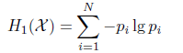
Shannon entropy
It is a measure of the “uncertainty” of X to an attacker.
Introduced by Shannon in 1948
It has been demonstrated that H1 is mathematically inappropriate
as a measure guessing difficulty
For an attacker who must guess individual passwords, Shannon entropy has no direct correlation to guessing difficulty

Slide 8
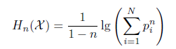
R´enyi entropy
R´enyi entropy Hn is a generalization of Shannon entropy, parametrized by a real number n ≥ 0 :
R´enyi entropy
Hartley entropy H0
For n = 0
Min-entropy H1
As n = ∞
H0 = lgN
H1 = - lg p1

Slide 9
Guesswork
A more applicable metric is the expected number of guesses required to find X if the attacker proceeds in optimal order, known as guesswork or guessing entropy.
it models an attacker who will exhaustively guess even exceedingly unlikely events which can produce absurd results.
Withdraw :
Guesswork and entropy metrics fail to model the tendency of real-world attackers to cease guessing against the most difficult accounts.

Slide 10
Partial guessing metrics
Having many accounts to attack is an important resource for a real attacker, as it enables a partial guessing attack which trades a lower proportion of accounts broken for increased guessing efficiency.
Formally, if Eve must sequentially guess each of k passwords drawn from X.
However, a second guesser Mallory willing to break only l < k of the passwords can do much better with the optimal strategy of first guessing the most likely password
for all k accounts, then the second-most likely value and so on.
As l decreases, Mallory’s efficiency increases further as the attack can omit progressively more low-probability passwords.

Slide 11
Application in practical security evaluation
For an online attacker we can use λB with B equal to the guessing limits imposed by the system.
There is no standard for B , with 10 guesses recommended by usability studies, 3 by FIPS guidelines , and a variety of values (often∞) seen in this study.

Slide 12
PRIVACY-PRESERVING EXPERIMENTAL SETUP
By using statistical guessing metrics to evaluate passwords, now the question is about accessing passwords in their original form.
Users may be willing to provide passwords to researchers with ethics oversight.
In contrast, leaked data sets provide unquestionably valid data but there are ethical questions with using stolen password data and its availability shouldn’t be relied on.
The researchers addressed these problems with a novel experimental setup and explicit cooperation from Yahoo!
Yahoo maintains a single password system to authenticate users for its diverse suite of online services.

Slide 13
PRIVACY-PRESERVING EXPERIMENTAL SETUP cont..
The experimental data collection was performed as a hashing password which reduce the pre-computed dictionary attacks.
A stream of pairs (u; password u) for each user u logging in to any Yahoo! service.

Slide 14
Deployment details
The code was implemented using Perl language
R language generated to do the statistical matrics.
The experiment was approved by Yahoo!’s legal team as well as the responsible ethics committee at the University of Cambridge.
The researcher deployed his experiment on a random subset of Yahoo! servers for a 48 hour period from May 23–25, 2011.
observing 69,301,337 unique users and constructing separate histograms for 328 different predicate functions.
Notes:
Of these, many did not achieve a sufficient sample size to be useful and were discarded.

Slide 15
EFFECTS OF SAMPLE SIZE
In the mathematical treatment of guessing difficulty, the researcher assumed complete information is available about the underlying probability distribution of passwords X.
In practice, the researcher will need to approximate X with empirical data.
the researcher assumed that he has M independent samples
X1;….. ;XM R X and we wish to calculate properties of X.

Slide 16
Method
maximum-likelihood estimation.
Applied inverse-Gaussian distribution to estimate the error.
The researcher used a Poisson distribution with expectation p.M to model the number of times we observe this password

Slide 17
ANALYSIS OF YAHOO! DATA
The researcher first compared his collected data to several known data sets.
RockYou data set.
Comparing subpopulations WITHIN Yahoo
Users’ account history illustrates several interesting trends.

Slide 18
Strong trends
There is a clear trend towards stronger passwords amongst users who actively change their password, with users who have changed passwords 5 or more times being one of the strongest groups.
users who have recently logged in from multiple locations choose relatively strong passwords.
users with a large amount of stored data choose better passwords.

Slide 19
Weak trends
There is a weaker trend towards stronger passwords amongst users who have completed an email-based password recovery.
The researcher observed Users who have used Yahoo!’s online retail platform (which means they have stored a payment card) do choose very weak passwords.
Notes:
However, users who have had their password reset manually after reporting their account compromised do not choose better passwords

Slide 20
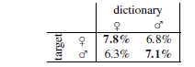
Effects of dictionary specificity
A simple example is to compare male and female-chosen passwords.
There is a 10–15% loss in efficiency if an attacker uses the optimal male dictionary against female-chosen passwords, or vice-versa.

Slide 21
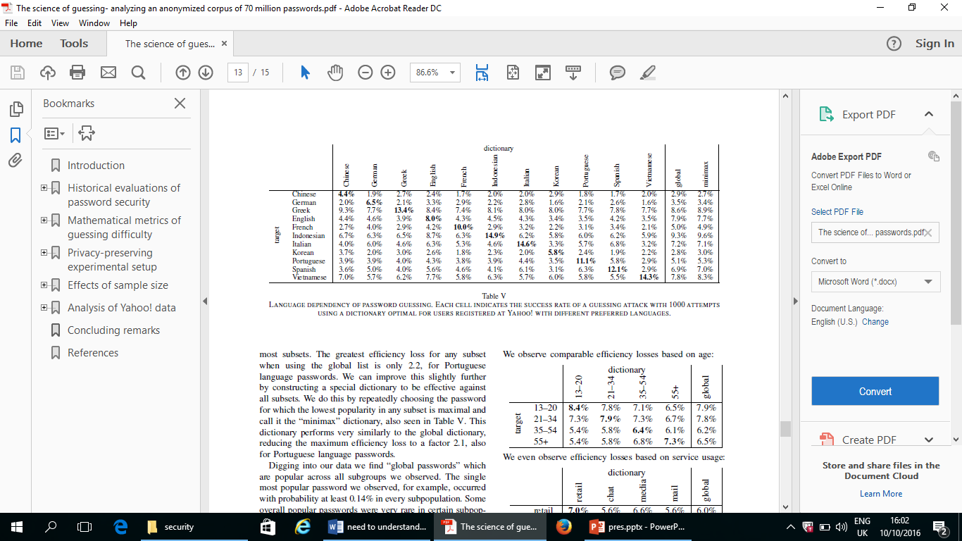
Effects of dictionary specificity
Researchers compare the efficiency loss when using a password dictionary from users of different languages, perhaps the most inappropriate dictionaries possible. Surprisingly, the worst efficiency loss observed is only a factor of 4.8, when using an optimal Vietnamese-language password dictionary against French speakers’ passwords.

Slide 22
Conclusion
An attacker who can manage 10 guesses per account, typically within the realm of rate-limiting mechanisms, will compromise around 1% of accounts, just as they would against random 10-bit strings.
The password secure is good if it is chosen well, and it will provide a high resistance to guessing.

